Slide 1
Machine Learning for Optic Correction in the LHC
Alejandro Börjesson Carazo
23/04/2023

Slide 2
Summary
Introduction
Background
Methods
Results
Error simulation
Twiss beta beating
ML Model evaluation
Problems
Conclusion
Backup slides

Slide 3
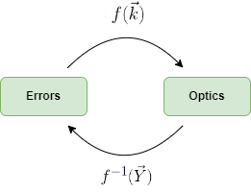
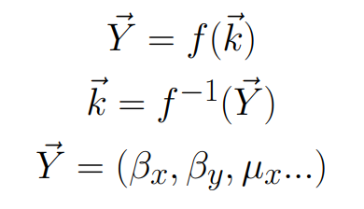
Methods: Data pipeline
Actual methods for quadrupole magnetic error correction consist on knob tuning, response matrix (????)…
Problems, no information on the actual magnet errors
Correcting the optics, but not the actual magnet errors!
Machine learning promises multiple new ways to manage quadrupole errors
The effect of magnet errors on optics can be calculated using simulation software
ML can be used to model the relation between optics and errors regardless on how complex is

Slide 4
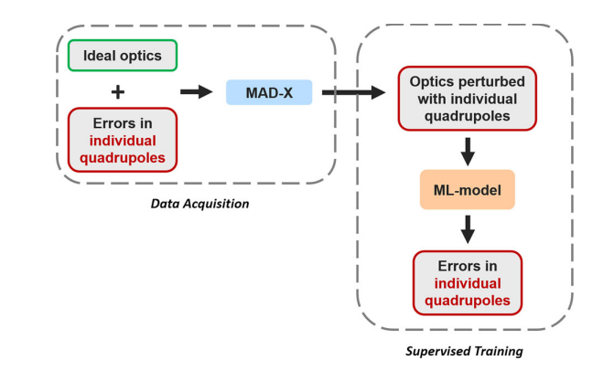

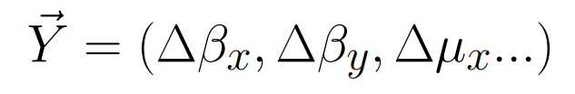
Methods: Data pipeline
Simulating random quadrupole strength errors the corresponding twiss parameters for data generation
Possible improvements to data generation include using MAD-NG or adding noise
Fig 1. Data pipeline

Slide 5
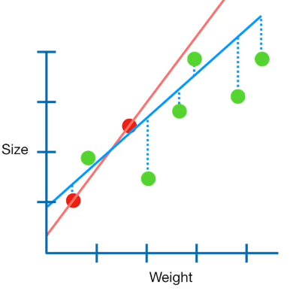
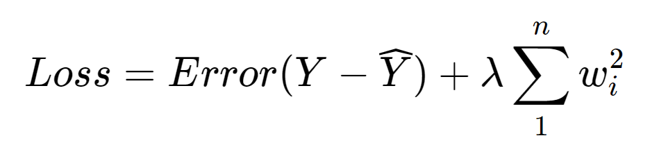
Methods: ML Model
Ridge and Linear Regression:
Least squares regression with L2 regularization
Bagging:
Training using ten different subsets of data and averaging the results.
This methods decreases variance of the model and overfitting
Fig 2. Example Ridge regression

Slide 6
Results: Error Simulation
Elena used 2016 40 CM optics so the whole MADX script had to be updated, repurposing error generation
Generating 80k Samples using 2023 30 CM optics, errors seem to be too big for this optics 15% of twiss failed!
Also generating samples for 2023 45 CM!
All results shown are for 2023 30 CM optics

Slide 7
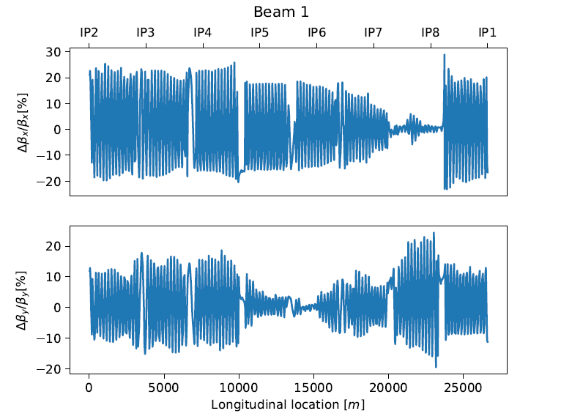
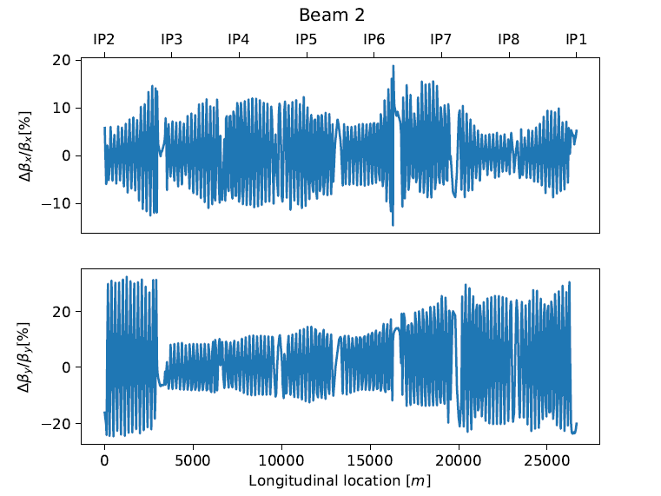
Results: Error Simulation
Fig 3. Example Beta Beating

Slide 8
Results: Model Training
Decision tree regression: Not worth considering
Algorithm | Corr Coef: | Mean Abs Err: MAE
Ridge Regression | Train: | Train:
 | Test: | Test:
Linear Regression | Train: | Train:
 | Test: | Test:

Slide 9
Results: Example prediction
Fig 4. Quadrupole error prediction example

Slide 10
Results: Error Histogram Prediction
Fig 5. Quadrupole error histograms for 200 test samples

Slide 11
Conclusion: Problems
Fig 5. Quadrupole error histograms for 200 test samples

Slide 12
References
Fig 1. Data pipeline. "Supervised learning-based reconstruction of magnet errors in circular accelerators" by E. Fol, 2021, https://doi.org/10.1140/epjp/s13360-021-01348-5
Fig 2. Example Ridge regression. “Regularization Part 1: Ridge (L2) Regression" by J. Stamer, 2018, https://www.youtube.com/watch?v=Q81RR3yKn30

